Slide 1
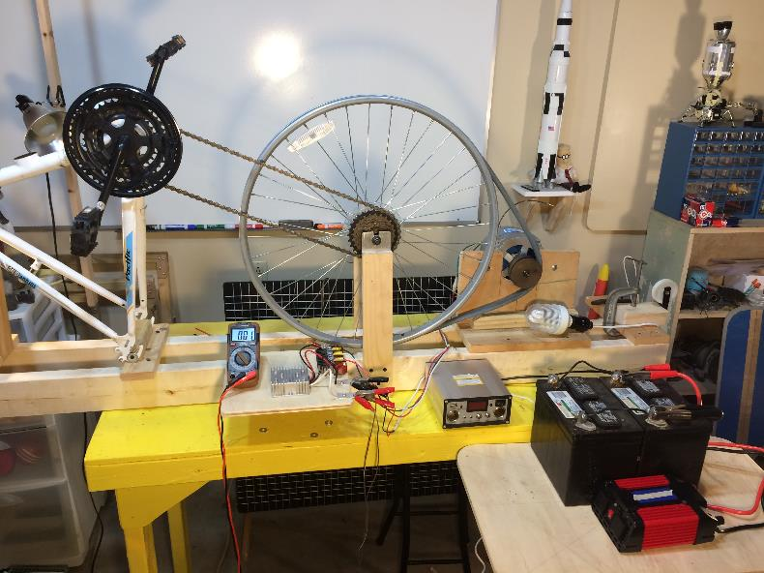
Renewable Energy
Hydroelectric – Part 1
(Design)
LabRat Scientific
© 2019

Slide 2
This lesson provides testing and engineering insights for developing a crude, home-built, hydroelectric generator using a Permanent Magnet Alternator (PMA), associated electrical components, and a wooden water wheel.
This lesson utilizes an experimental test set up for making torque and speed measurements that are used to design an appropriately sized water wheel to drive the system. The water wheel construction and testing are addressed in Part 2 of this educational series.

Slide 3
SAFETY WARNING:
The components outlined in this lesson can be hazardous. The chains and sprockets pose a severe pinch hazard. Electrical components can generate excessive heat and high voltages that can cause injury. Appropriate safety precautions and supervision are required to conduct the experiments in a safe manner.

Slide 4
Experimental Hardware
The bike peddles are cranked manually. The bike chain spins the bike wheel. The bike wheel is coupled to the alternator via a V-belt.
This rig was developed to study mechanical load requirements and associated electrical system performance in order to design a water driven power system.

Slide 5
Experimental Hardware
Wheel Radius = 0.28 m
Circumference = Pi x D
= 3.1416 x 0.56 m
= 1.76 m
Bicycle Wheel
0.28 m
V-Belt
0.035 m
Pulley Radius = 0.035 m
Circumference = Pi x D
= 3.1416 x 0.07 m
= 0.22 m
Permanent Magnet Alternator
Pulley Ratio = 1.76 / 0.22 = 8.0
The “pulley ratio” can also be calculated just by using the radii… For every rotation of the big wheel, the alternator pulley will spin 8 times.

Slide 6
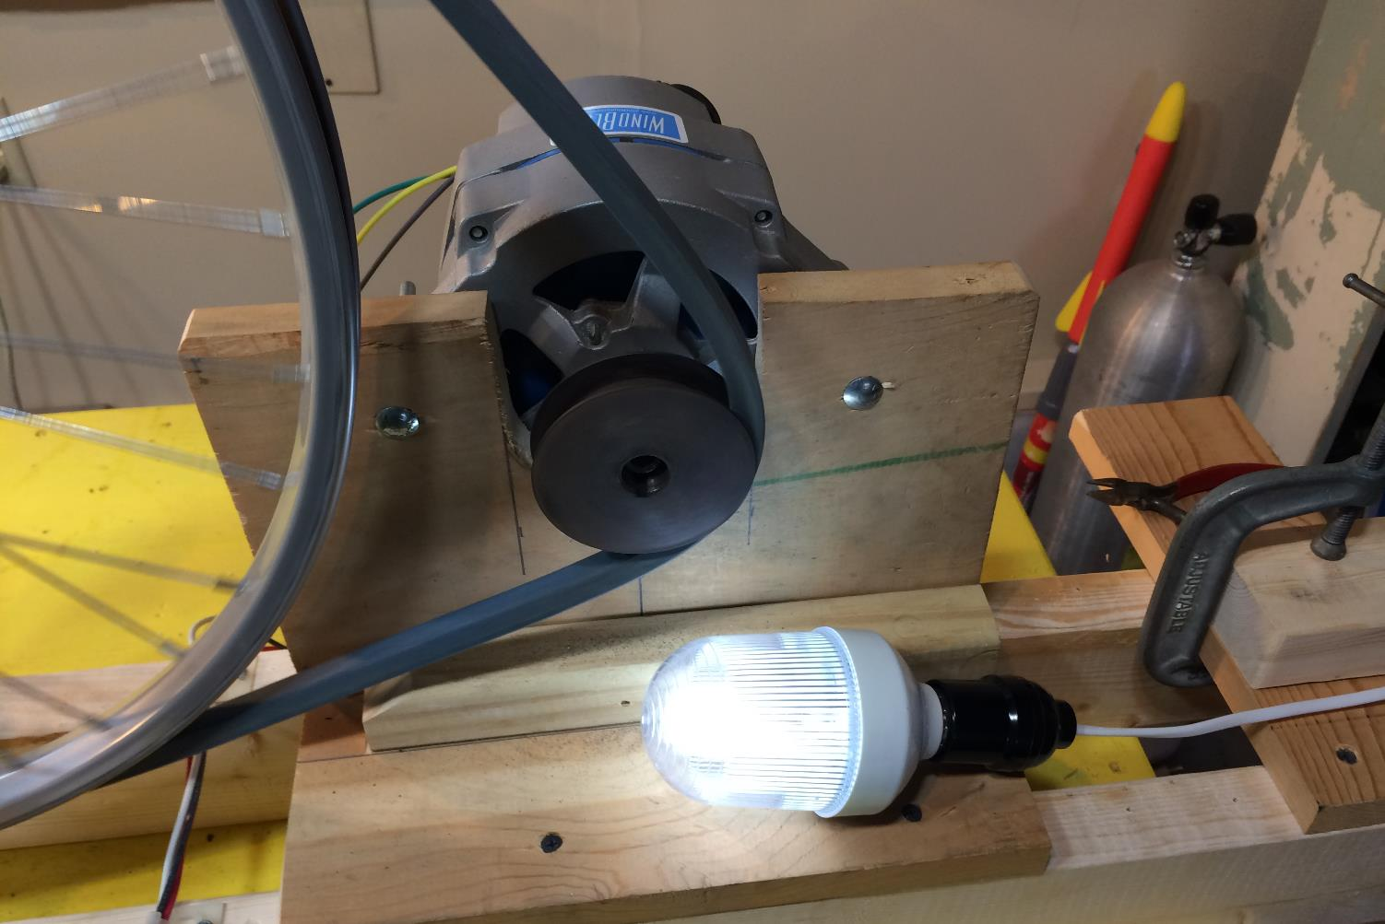
Alternator system powering a 12 VDC light bulb.
1 rev/sec
8 rev/sec
12 VDC Light Bulb

Slide 7
Ideal Electrical Configuration
115 VAC 60 Hz Power
Power
Inverter
Typically contained within the modern automobile alternator
Steady
12 V DC
AC
Voltage
DC
Voltage
Steady
12 V DC
12V Battery
Bridge Rectifier
12 V Regulator
Charge Controller
Alternator
CAUTION! - Electrical components can cause electrical shock and injury. Car batteries are capable of providing very high electrical currents that can cause severe injury. Proper safety practices and supervision are required!

Slide 8
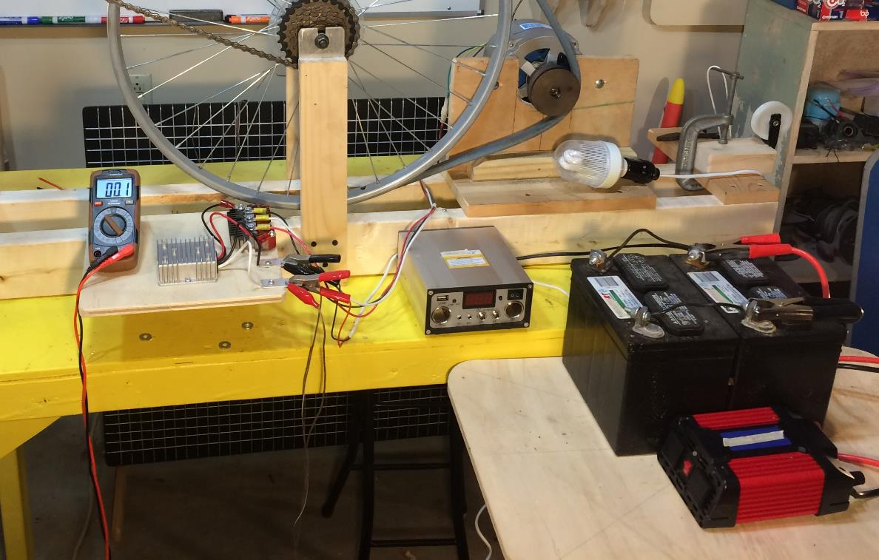
Electrical Set-up
Bridge Rectifier
Alternator
Volt Meter
Batteries
DC-DC Converter
Power Inverter
Charge Controller

Slide 9
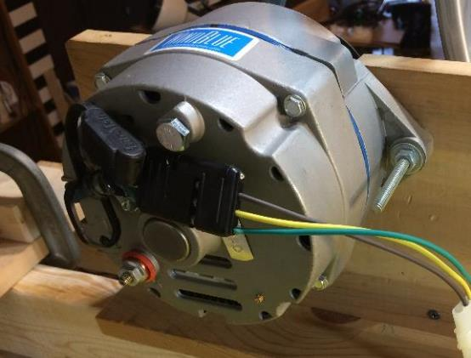
Permanent Magnet Alternator (PMA)
Alternators are used in cars to generate voltage to recharge the car battery and run electrical systems.
Alternators generate an Alternating Current (AC).
A car alternator has internal circuits to convert the AC electricity into 12 VDC electricity to be used in the car circuits.
Alternators are better than generators because the generate voltage more efficiently.
This alternator has been converted to a Permanent Magnet Alternator (PMA). It does not require 12 V to energize an internal electromagnet coil.

Slide 10
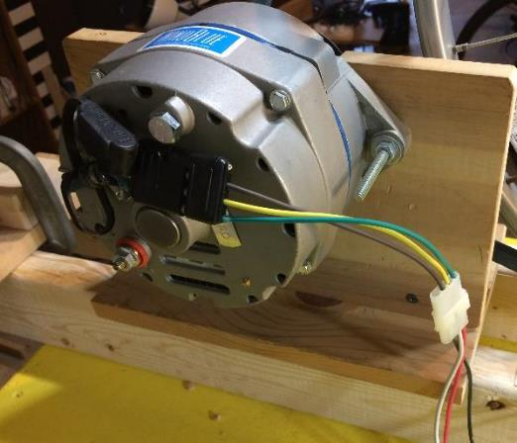
Permanent Magnet Alternator (PMA)
While a standard alternator can be used, the alternator used in these experiments uses permanent magnets instead of the standard electromagnetic coil – making it a Permanent Magnet Alternator (PMA). This eliminates the need for an external 12 VDC power source to energize the coil.
Standard alternators include an internal Bridge Rectifier to output a DC voltage. The PMA alternator has also been modified to output the “raw” 3-phase AC voltage. AC power can be transmitted over longer distances better than DC power. This is useful when it comes to wind turbines and water wheels because they are generally installed some distance from where the power is actually needed.

Slide 11
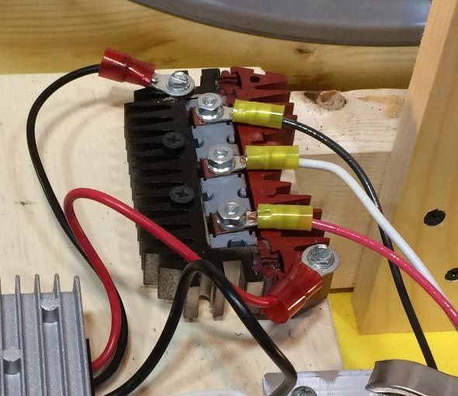
Bridge Rectifier
The AC output of the PMA is connected to an external Bridge Rectifier which converts the voltage into Direct Current (DC). This device would be located near the location needing the power.
The AC voltage generated by the alternator, is a function of the rotational speed of the alternator. This in turn means the voltage output by the Bridge Rectifier is also speed dependent. A fast spinning alternator can generate more than 30 volts.

Slide 12
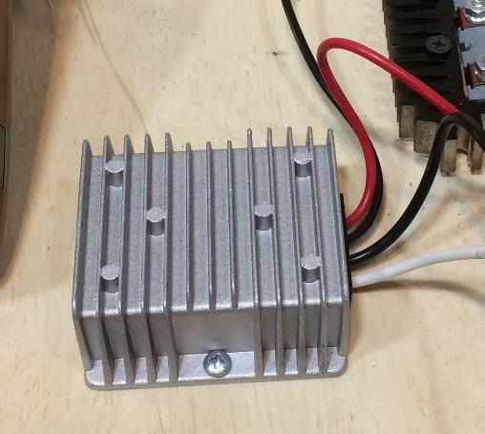
DC-DC Converter
A steady 12 VDC output is needed for battery charging and operating an inverter. This is done using a DC-DC converter which converts the high input voltage to a constant 12 VDC.
The “excess” voltage is dissipated as heat – hence the fins on the casing.

Slide 13
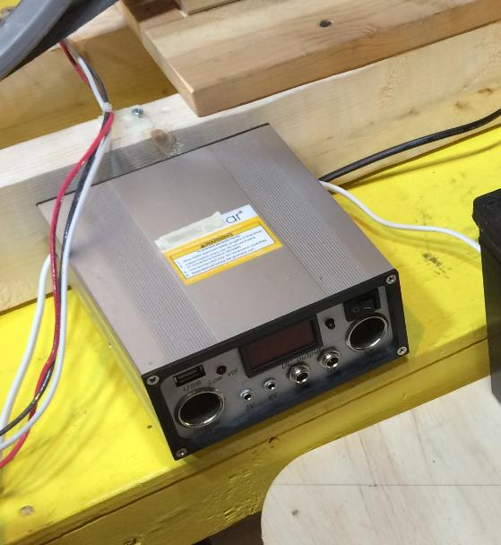
Charge Controller
The Charge Controller is used to ensure the battery is not over charged. This protects the battery from damage.

Slide 14
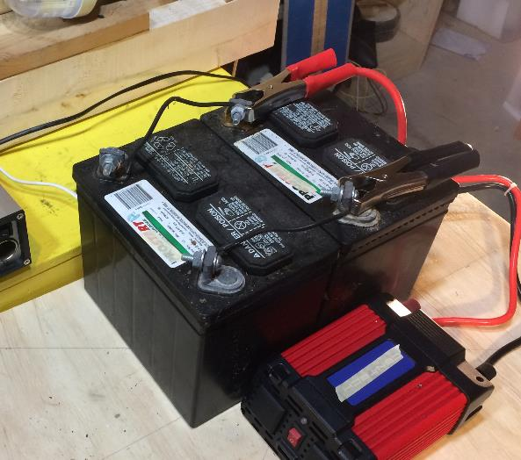
Batteries
The hydroelectric generator system described in this lesson cannot power AC devices directly. Instead the system is used to recharge a bank of batteries which is capable of providing the current needed to power larger electrical devices via the inverter.
In these experiments two lawn tractor batteries are being used. Ideally, “deep discharge” batteries should be used since they are designed to be “drained” down to low voltage without damage. Deep discharged batteries are typically used in vehicles that don’t have alternators such as pleasure boats and golf carts.

Slide 15
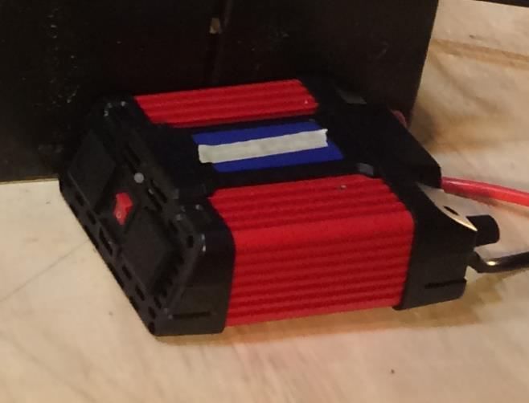
Power Inverter
The Power Inverter converts the 12 VDC into 115 VAC at 60 Hertz. This allows the system to power AC devices such as light bulbs, power drills, microwave ovens, and electric fans.
A 700 Watt inverter was used in these experiments.

Slide 16
Mechanical energy needs to be generated in order to turn the alternator and generate the electricity.
The first step in designing a system is to determine how much torque is needed to operate the alternator under an electrical load.

Slide 17
Determining the Torque Required to Drive the System
A Pull Test was conducted on the alternator to determine the torque needed to get it to spin at the proper speed.
Alternator
0.035 m
PULL
Load Cell
Bridge Rectifier
The cord was pulled at a speed that caused the bulb to illuminate brightly…
Note: The wheel is not connected to the alternator pulley in this test.
12 VDC Light Bulb

Slide 18
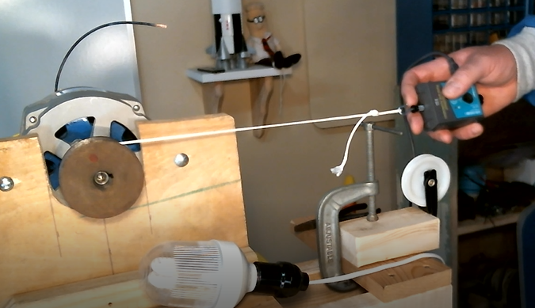
Alternator Pull Test
25 N
(with electrical load)
NOTE: The force required depends on the speed of the pull. All pull tests were conducted at a speed near the expected operational speed.

Slide 19
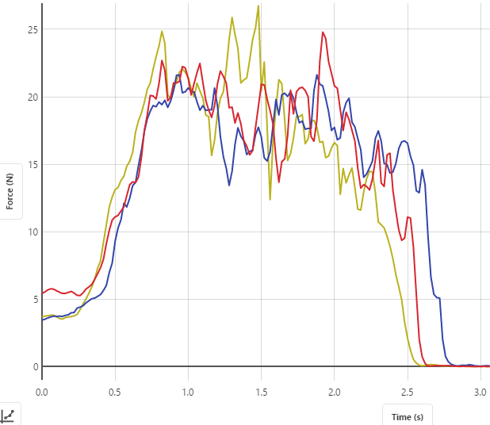
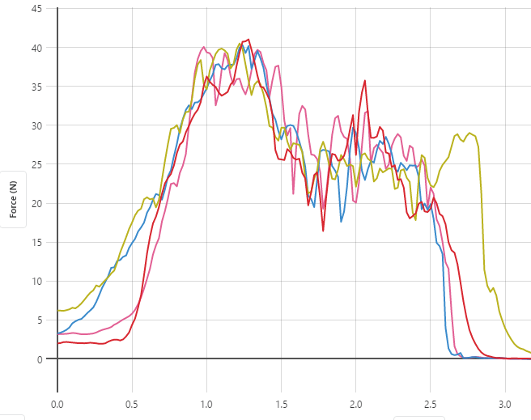
Alternator Pull Test Results
No Electrical Load:
Torque_{Required} = Force x Radius
Torque_{Required} = 17 N x 0.035 m = 0.6 Nm
17 N
Small Electrical Load:
Torque_{Required} = Force x Radius
Torque_{Required} = 25 N x 0.035 m = 0.9 Nm
25 N

Slide 20
Determining the Torque Required to Drive the System
The torque required to spin the wheel (which then spins the alternator) was determined by pulling on the edge of the wheel with a load cell while it is connected to the alternator via the V-belt..
PULL
Load Cell
0.28 m
Alternator
Various tests were conducted with no electrical load connected to the alternator output and then with a 12 VDC light bulb connected.
Bridge Rectifier
Note: The wheel is connected to the alternator pulley in this test.
12 VDC Light Bulb

Slide 21
Theoretical Wheel Torque needed to Rotate the Alternator
Force measured from alternator pull test (w/ electrical load)
25 N

Slide 22
Theoretical Wheel Torque needed to Rotate the Alternator
The V-belt pulls on the alternator pulley.
25 N
0.28 m
Ideally, if we pull on the edge of the wheel with 25 N, the alternator should spin at the desired speed. However, if there is friction in the system, the actual pull force may be higher...
25 N
The ideal (theoretical) torque is calculated as follows:
Torque = Force x Distance
= 25 N x 0.28 m
= 7.0 Nm
Force measured from alternator pull test (w/ electrical load)

Slide 23
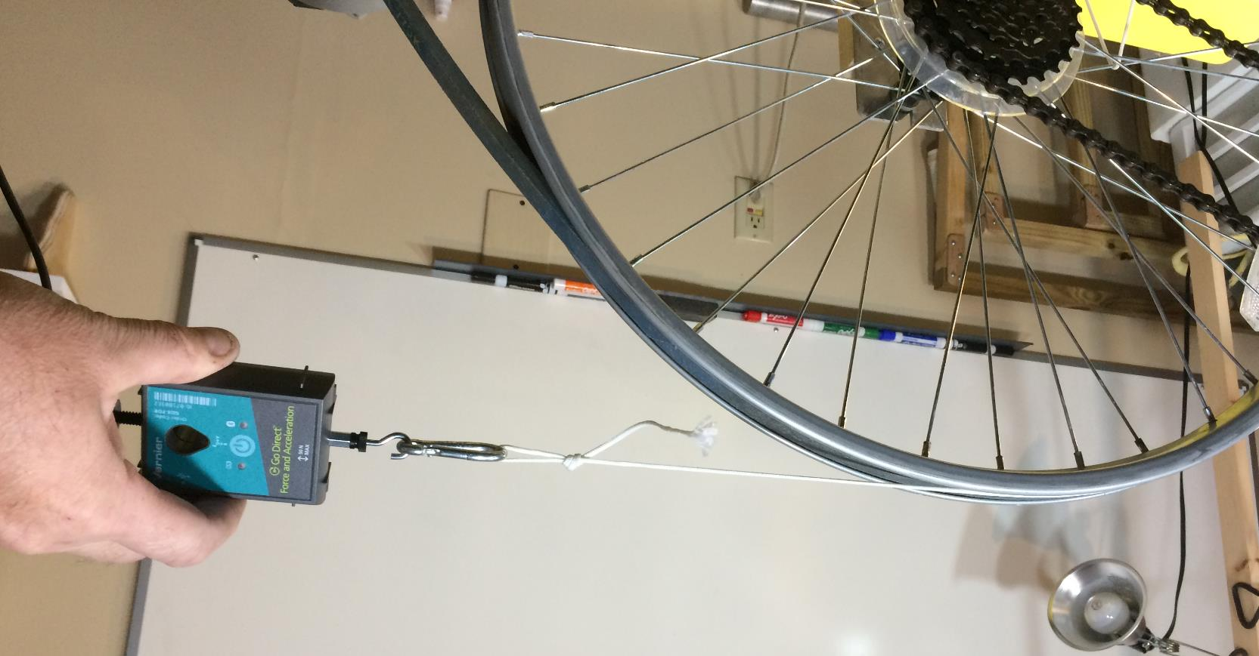
Wheel Pull Test (w/ electrical load)
Note: This force is greater than the theoretical 25 N.
32 N (with electrical load)
NOTE: The force required depends on the speed of the pull. All pull tests were conducted at a speed near the expected operational speed.

Slide 24
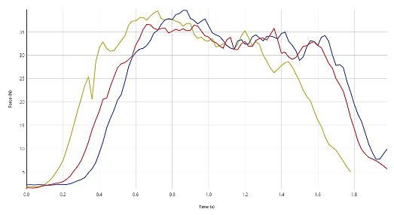
Wheel Pull Test Results
The actual pull-load on the bicycle wheel (32 N) was higher than that which was predicted by the pull test on the alternator alone (25N).
32 N
This means there must be mechanical resistance in the wheel and belt system.
12 VDC light bulb connected

Slide 25
Wheel Pull Test Results
32 N
With 12VDC Electrical Load Connected:
Torque_{Required} = Force x Radius
Torque_{Required} = 32 N x 0.28 m = 9.0 Nm
12 VDC light bulb connected

Slide 26
Theoretical vs. Measured
 | Torque (Nm)
Theoretical Torque | 7.0
Measured Torque | 9.0
Approximately 33% more torque is required to overcome belt and bearing friction that is present in the system.
This serves as a baseline design factor when designing a water wheel or wind turbine to spin the alternator. For an initial design, provide at least 33% more torque than is required to spin the alternator. Maybe more, maybe less depending on the relative complexity of the mechanical system.

Slide 27
Effect of Electrical Load
 | Torque (Nm)
Alternator – No Load | 0.6
Alternator – Loaded | 0.9
Wheel – No Load | 5.6
Wheel – Loaded | 9.0
The test data indicates that as the electrical load increases, so does the torque needed to spin the system. Approximately 50% more torque is required even with a relatively small electrical load. This factor will tend to grow as electrical load increases. This must be taken into consideration when approximating the amount of torque that will be needed for a particular configuration.

Slide 28
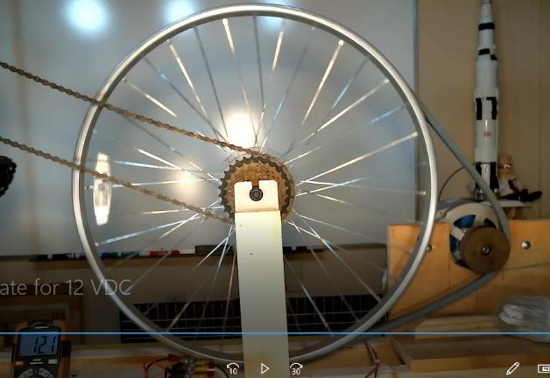
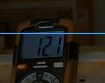
Rotation Rate needed for 12 VDC Output
An experiment was conducted to determine the wheel rotation rate needed to produce a steady 12 VDC output.
Using video data, 5 rotations of the large bike wheel were timed while the system was generating 12 VDC. The 5 rotations took ~12 seconds, resulting in a spin rate of 0.42 Revolutions per Second (RPS).
Applying the 8:1 pulley ratio determined earlier, the alternator was spinning at 3.3 RPS.

Slide 29
Generating the Necessary Mechanical Energy
It’s not practical to manually spin the alternator by hand (or foot). It takes a fairly long time to re-charge the batteries and thus some sort of continuously operating system is needed to provide the rotational energy. This can be done in several ways, including wind power and water power.
This lesson outlines how to spin the alternator using water power. A simple top-fed water wheel will be designed to meet the mechanical energy needs of the system.

Slide 30
1.0 m Diameter Water Wheel
Water will enter the wheel at the top.
10 cm
Water will spill out as the wheel rotates approximately 100 degrees.
Examining the geometry of the wheel configuration indicates that that 5 compartments will contain of water at any given time.

Slide 31
Water Wheel Geometry
Experimental Water Wheel:
15 Water Compartments
1.0 m diameter side disks made from plywood
18.4 cm (7.25”) wide 1.9 cm (¾”) thick wood planks to create compartments
Seams sealed with caulk
15
1
14
2
13
3
0.25 m
4
12
0.5 m
5
11
Note: The 1.0 m diameter was somewhat arbitrarily selected to ensure the wheel would have a good chance of working…
6
10
21 cm
9
7
8

Slide 32
Approximating the Weight of Water in each Compartment
Water Volume₁ = ½ x 0.25 m x 0.1 m x 0.185 m = 0.0023 m³
1
2
3
Water Weight₁ = Density x Volume
= 9800 N/m³ x 0.0023 m³
= 22.7 N
4
For estimating purposes, it is assumed that the weight of water is the same in compartments 1, 2, 3, and 4. The weight of water in compartment 5 is estimated to be 50% of the others.
5

Slide 33
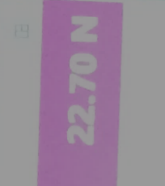
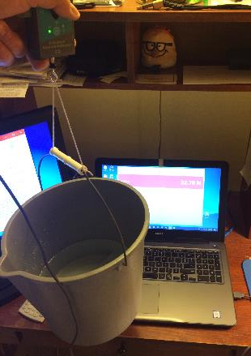
Verifying the Weight of the Water
Calculating the volume of water in Liters:
Load Cell
1 Liter = 0.001 m³
1 Liter
0.0023 m³ x -------------- = 2.3 liters
0.001 m³
A digital load cell was used to verify that the assume “water cell” volume actually weighed the calculated 22.7 N.
Note: The load cell value was oscillating around 22.7 N and it just so happened that 22.7 N was captured in the photo (the world usually isn’t this perfect…)
2.3 L
of Water
Weight of bucket was nulled out

Slide 34
Approximating the Moment Arms for each Water Compartment
Since gravity is providing the force to rotate the wheel, the moment arm used is the horizontal distance from the axis of rotation to the Center of Gravity (CG) of each cell of water.
1
2
3
4
Estimated Moment Arms:
Compartment ₁ = 0.16 m
Compartment ₂ = 0.25 m
Compartment ₃ = 0.31 m
Compartment ₄ = 0.33 m
Compartment ₅ = 0.24 m
5

Slide 35
Calculating the Supplied Torque
The total torque generated by the water wheel is the sum of the torques generated by each compartment containing water. The total torque is calculated as follows:
Torque_{Supplied} = (22.7 N x 0.16 m) + (22.7 N x 0.25 m) + (22.7 N x 0.31 m) + (22.7 N x 0.33 m) + (11.4 N x 0. 24 m)
Torque_{Supplied} = (3.6 Nm) + (5.7 Nm) + (7.0 Nm) + (7.5 Nm) + (2.7 Nm)
Torque_{Supplied} = (26.5 Nm)

Slide 36
Calculating the Applied Torque
 | TORQUE (N*m)
Required (loaded) | 9.0
Supplied | 26.5
From the calculations on the previous slide, a 1.0 m diameter, 0.2 m wide, 15 cell water wheel will provide approximately 3x the torque needed to spin the alternator (with a small electrical load).
This excess torque is important due to the fact that as the electrical load increases (i.e. more light bulbs), the torque requirement will increase. There will also be mechanical losses due to friction in the mechanisms (bearings, belts, etc.) that will reduce the “effective torque” in the system.

Slide 37
Estimating Rotational Speed of the Water Wheel
The rotational speed of the water wheel will depend on several factors:
The torque provided by the volume of water in the compartments (generated moment)
The rate at which water fills the compartments (how much water is deposited in the compartments in a given time)
The electromechanical resistive forces acting on the wheel. Electromechanical resistive forces include general bearing friction and belt friction as well as the resistive force caused by the alternator and the electrical load.
As shown in a previous slide, experiments indicate that a minimum rotational speed of 0.42 rev/sec (2.63 Radians/sec) is needed to achieve a steady state 12.1 VDC output.

Slide 38
Effect of Water Flow Rate
The rate at which water flows into the water wheel compartments will have an effect on the speed of the wheel and the supplied torque. As the electrical load is increased more torque will be required. As a result, the wheel will slow down. As the wheel slows down, more water will enter each compartment in the water wheel increasing the torque to keep the system working. However, at some point the torque requirement may become too large and the compartments will overflow. At this point the wheel will stop turning because insufficient torque will be available.
Experiments must be conducted to get a feel for how the performance of the water wheel will be affected by the water flow rate (Part 2 of this lesson).

Slide 39
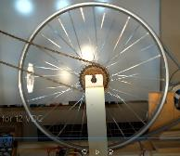
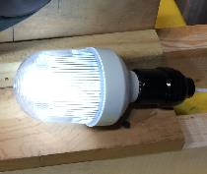
Overall System Efficiency
Power_{Rotational} = Torque (Nm) x Angular Velocity (Radian/sec)
P = Ƭ Ꙍ
P = 26.5 Nm x 2.63 Rad/sec (assume min rotational speed to get 12 VDC)
P = 69.9 Nm/sec = 69.9 Watts
Power_{Electrical} = Current (amps) x Voltage (voltage)
P = I V
P = 6.1 Watts (measured using power meter)
This indicates that the conversion of mechanical rotational power into electrical power is only about 10% efficient (Not good, but flowing water is free and continuous…)

Slide 40
Energy/Power Losses
Mechanical bearing and belt friction reduce efficiency.
The conversion of rotational energy into AC electrical energy in the alternator results in significant losses.
Converting the alternator output to a DC voltage (via the Bridge Rectifier) involves electrical losses in the form of heat.
Converting the DC voltage to 120 VAC (via the inverter) also results in electrical losses in the form of heat.

Slide 41
Work Done by the Water Wheel
Work is the area under the Torque-Rotation Angle curve
Work = ꭍ Ƭ dϴ
For constant Torque (Ƭ) Work becomes:
Work = Ƭ ( ϴ_{final} - ϴ_{initial} )
Assuming a constant water source, the wheel will perform endless work since the Theta Angle (ϴ) is constantly increasing ( meaning ϴ_{final} --> ∞ ).

Slide 42
QUESTIONS ?

